Slide 1
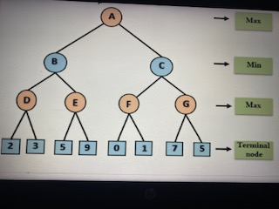
Calculate the value of each node using MiniMax algorithm

Slide 2
The two-parameter Apha and Beta can be defined as:
Alpha: The best (highest-value) choice we have found so far at any point along the path of Maximizer. The initial value of alpha is -∞.
Beta: The best (lowest-value) choice we have found so far at any point along the path of Minimizer. The initial value of beta is +∞.
Key points about alpha-beta pruning:
The Max player will only update the value of alpha.
The Min player will only update the value of beta.
While backtracking the tree, the node values will be passed to upper nodes instead of values of alpha and beta.
We will only pass the alpha, beta values to the child nodes.

Slide 3
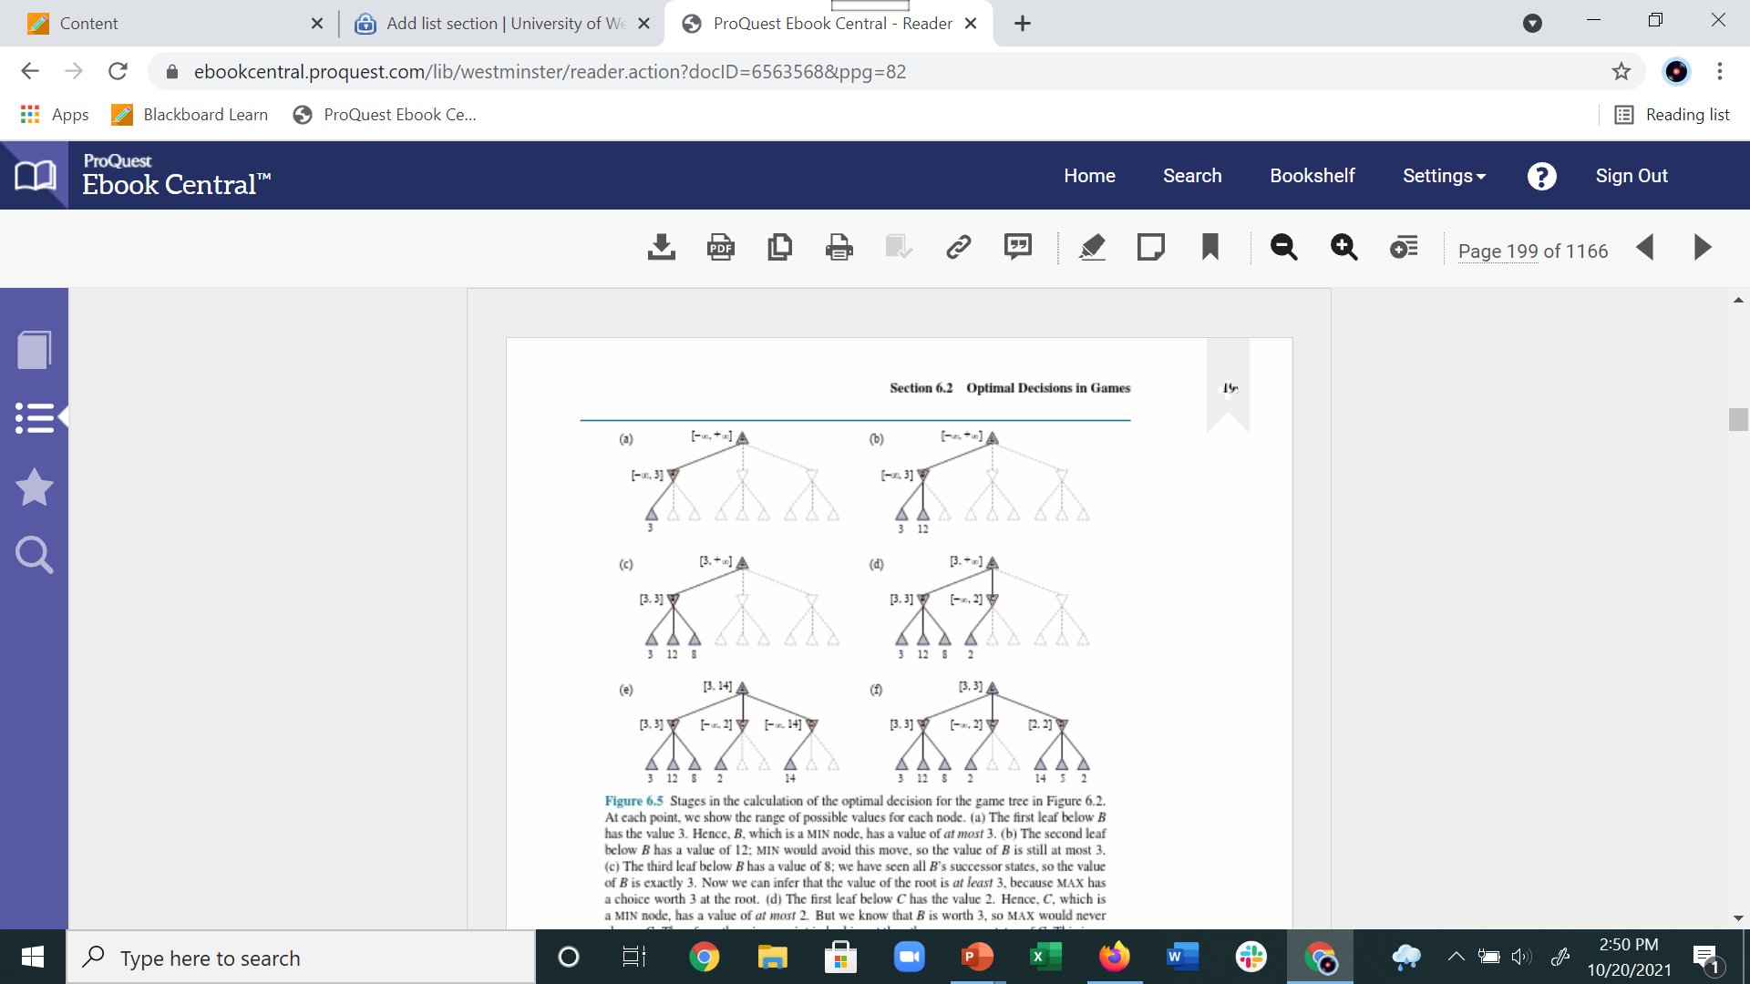
Alpha – Beta Pruning
Alpha – Maximum so far of MAX player “At least”
Beta - Minimum so far of MIN player “At most”

Slide 4
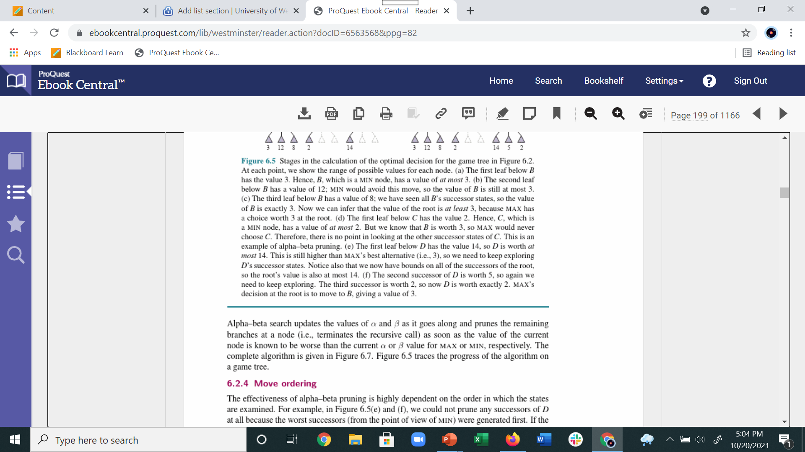


Slide 5
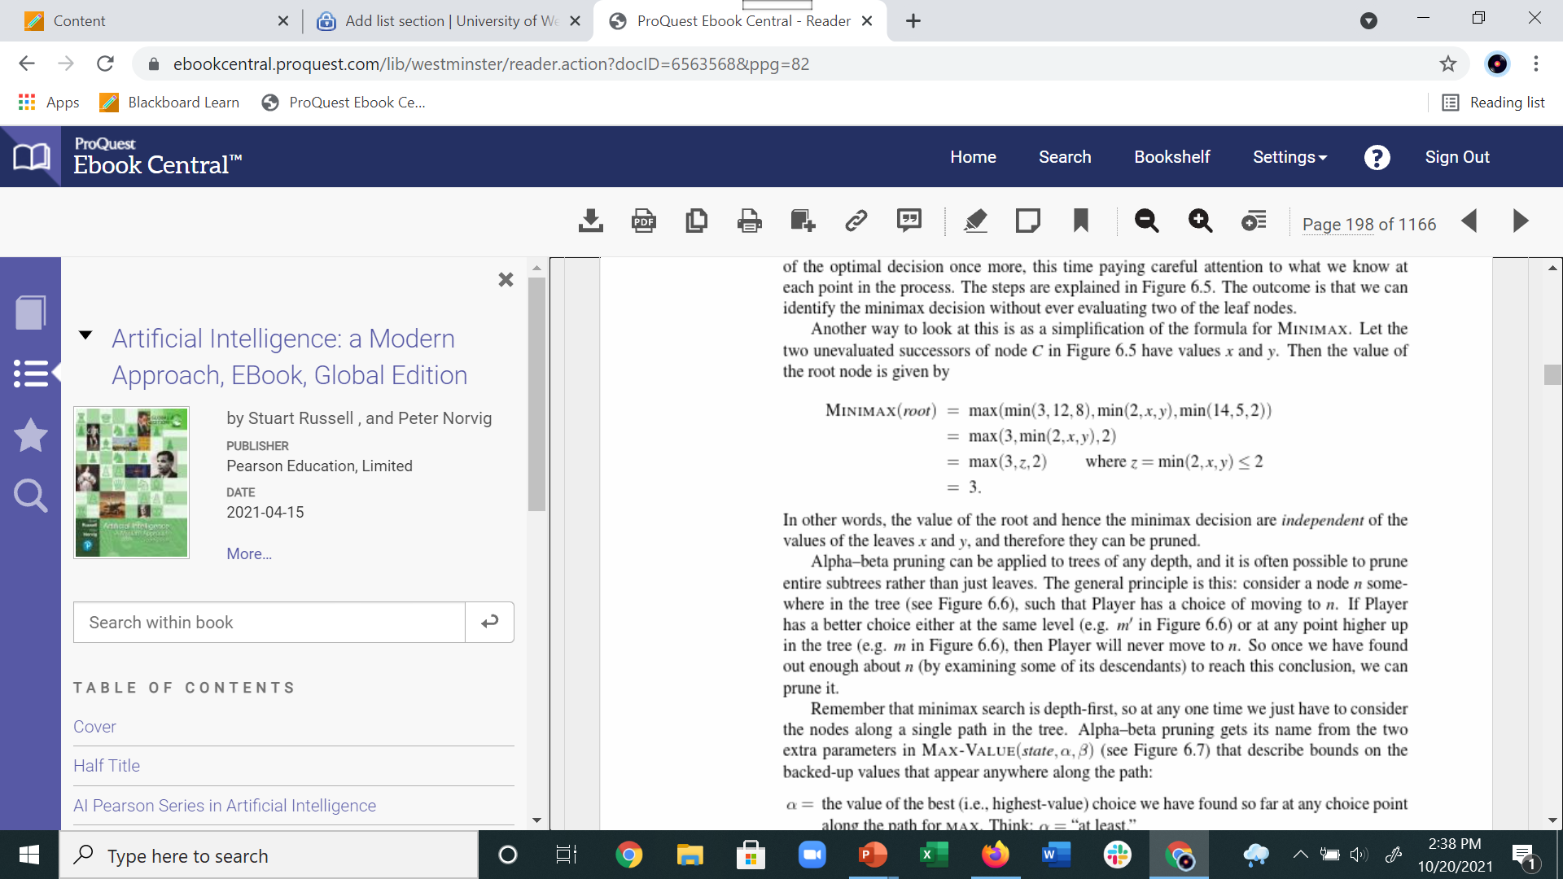
Root Value is independent of x and y. Therefore pruning x and y branches has no effect the root value

Slide 6
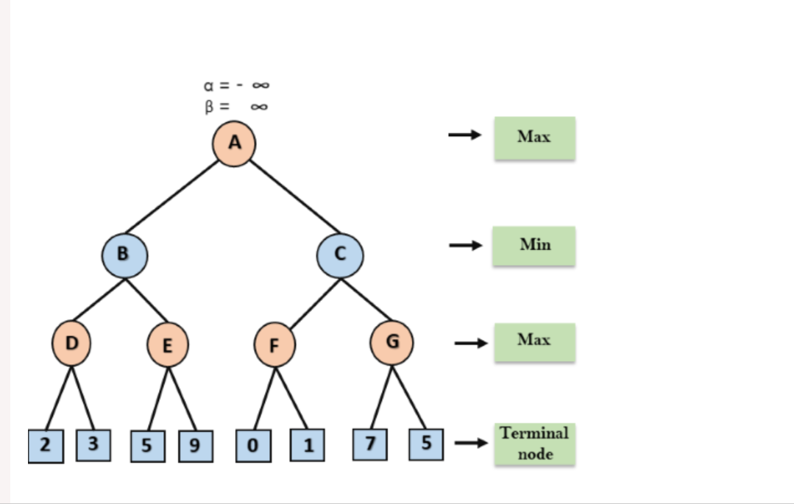
Exercise – Alpha-Beta Pruning
https://www.javatpoint.com/ai-alpha-beta-pruning

Slide 7
